Slide 1
World Earthquake Visualization
Project: Bootcamp Project 3
Team: Hua Wu & Carlos Hurtado
In the last 100 years

Slide 2
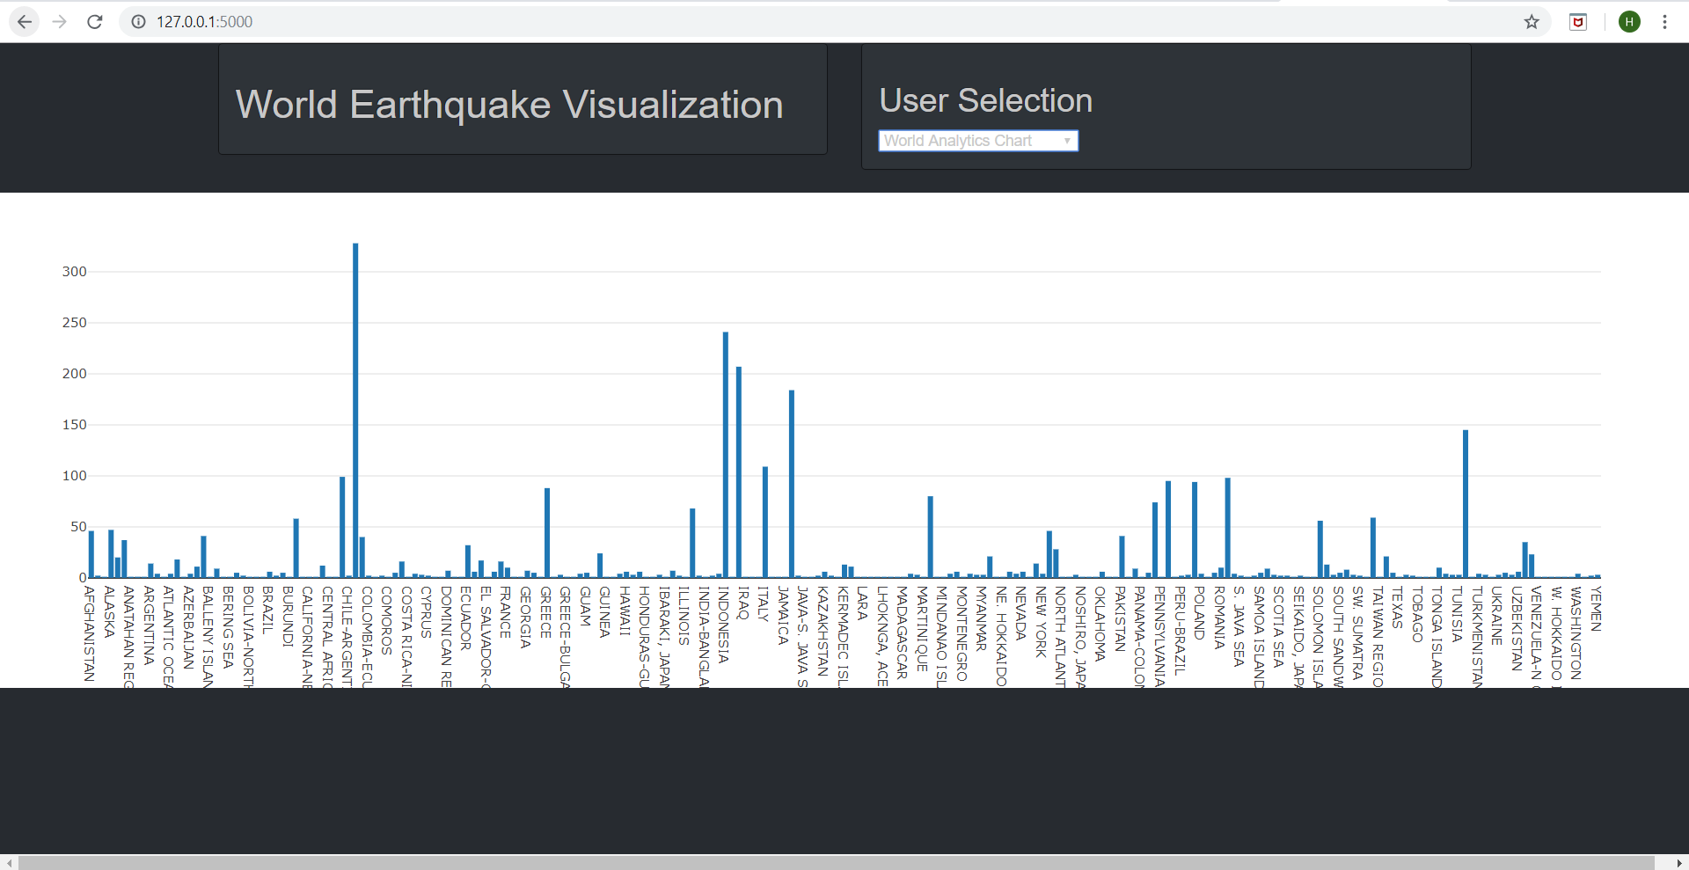
Project link: https://github.com/wuhua123/Project_3

Slide 3
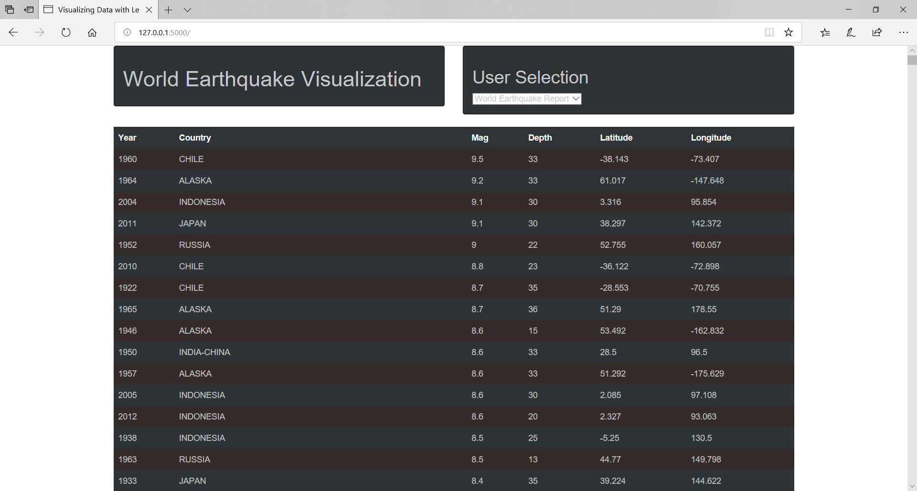
Mag >7 Earthquakes in the World for last 100 years

Slide 4
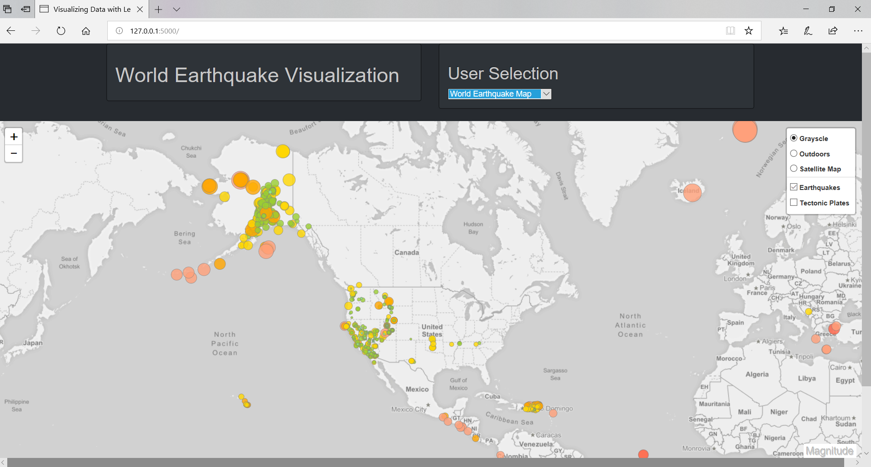

Slide 5
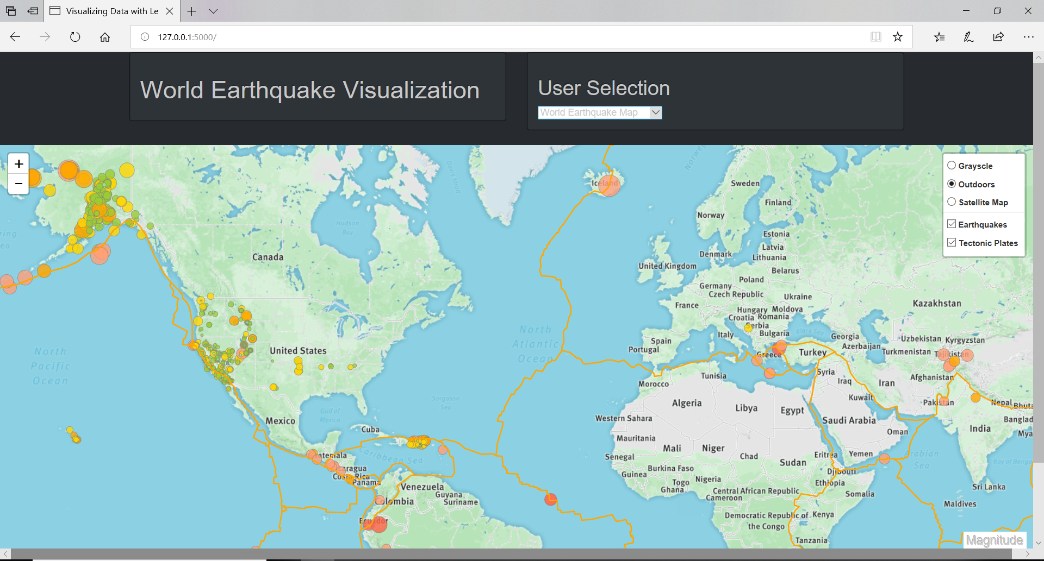

Slide 6
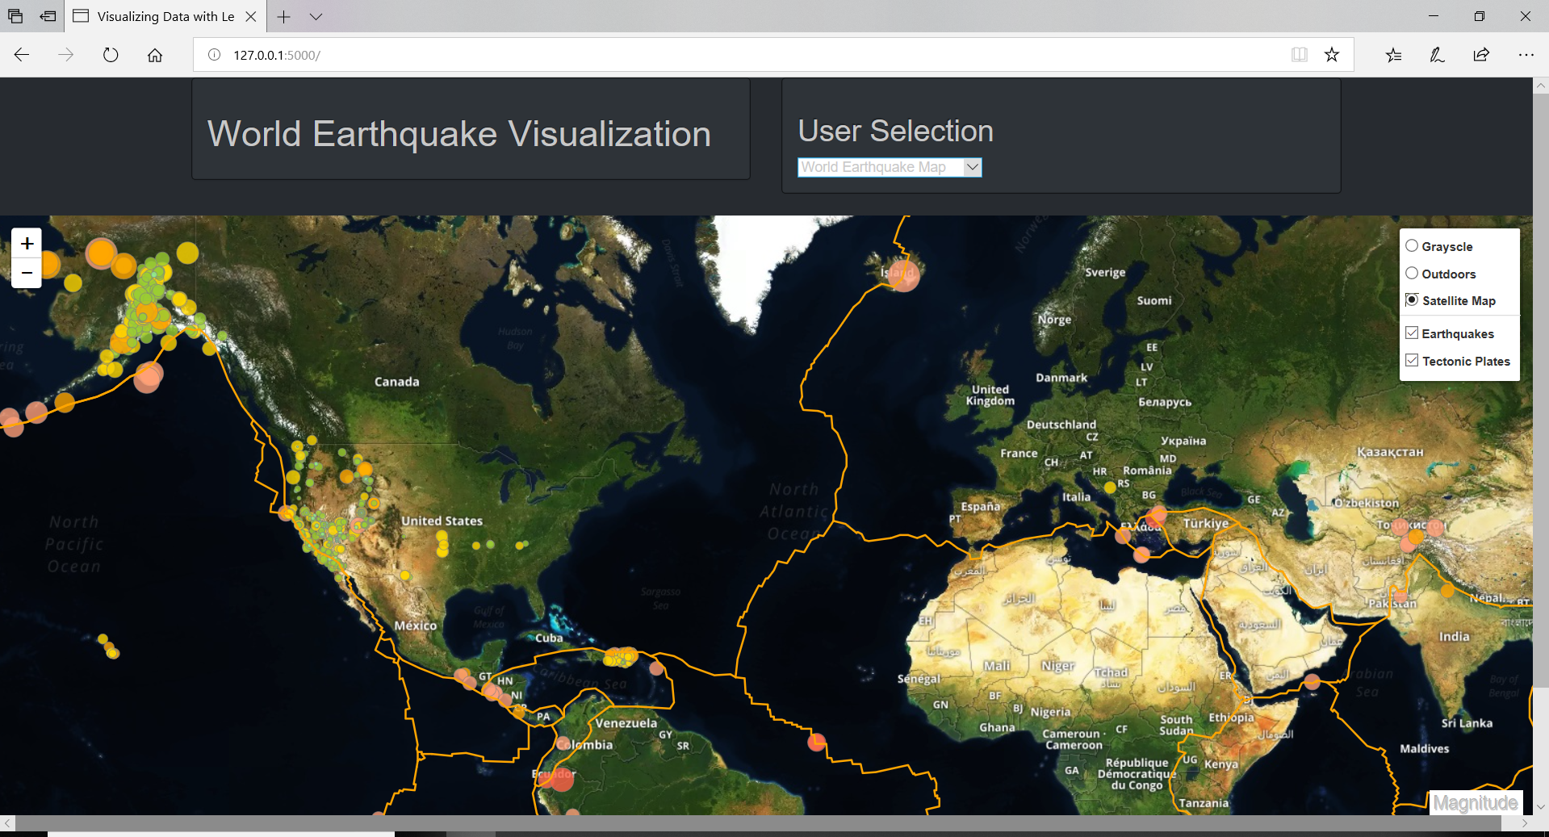

Slide 7
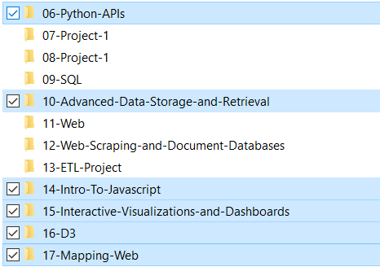
What We Learned?
In one word, they are all around a dynamic, interactive, and beautiful web page:
HTML, CSS
Javascript – Dashboard, Plotting, D3, Map, Leaflet, Bootstrap, Simple-Statistics
Sqlite Database, SQLAlchemy
Python – Flask
We also learned things beyond class. For example:
Jquery library – do you know how to clean the previous map and draw a new one? ☺
New skills to clean data in python
New skill to sqlite database – do you know how to check sqlite database table column data type? ☺
var container = L.DomUtil.get('map-id');
if(container != null){
$( "#map-id" ).remove();
var $newdiv1 = $( "<div id='map-id'></div>" ),
newdiv2 = document.createElement( "div" ),
existingdiv1 = document.getElementById( "marker-map-id" );
$( "body" ).append( $newdiv1, [ newdiv2, existingdiv1 ] );
};
cur = conn.cursor()
for row in cur.execute("PRAGMA table_info('100years')").fetchall():
print(row)

Slide 8
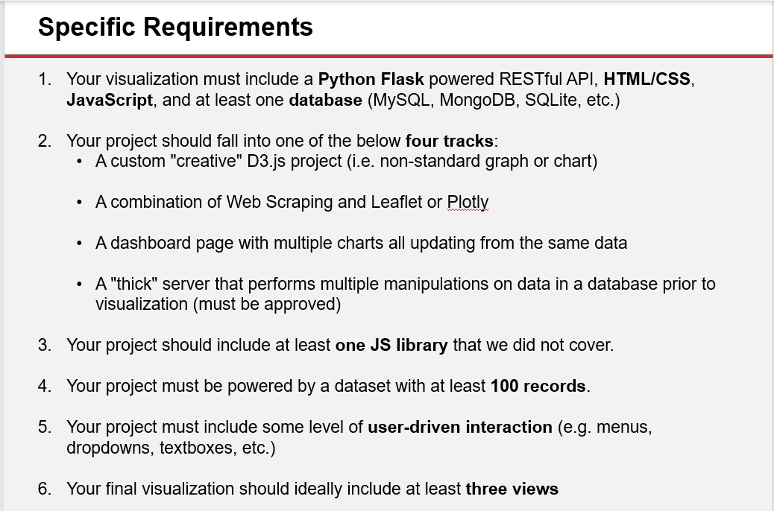




How your project met the project requirements outlined in the Power Point presentation?
1. SQLite
3. Jquery
4. >3000 records
5. Dropdowns

